Slide 1

Ports and Competitiveness
Being Competitive
is a MUST – Not an Option
David Anderson
CEO
Ports Australia
Building competitiveness in our export and maritime industries
Friday 24th August 2012 – Four Points by Sheraton, Darling Harbour, Sydney

Slide 2
The National Ports Strategy constitutes major national reform and is the foundation stone of the National Freight Strategy. Adequate landside access to port and the provision of channel capacity commensurate with the freight task are essential to the efficient operation of the whole economy – if they do not function properly it is immaterial whether the rest of the freight network is operating efficiently.
Ports Australia Submission to Infrastructure Australia (June 2010)

Slide 3
PORTS AUSTRALIA IN BRIEF
Branded as Ports Australia in 2007
  long history (1916) under various guises.
Typical business model for a peak industry body
represent both private and publicly owned ports, and regulatory agencies
company with Board of port corporation CEOs

Slide 4
Core business
advocacy (primarily on national stage)
advice to members on statutory and regulatory developments
sharing of information and best practice (9 working groups with strong member participation: Port Operations, Environment & Planning, Port Security, Accounting & Finance, IT, IR/HR, Work, Health & Safety, Engineers, Logistics
High level of agreement about what is important
Not an Industrial organisation

Slide 5
Board of Ports Australia
Gary Webb | CEO, Newcastle Port Corporation | Chairman
Vincent Tremaine | CEO, Flinders Ports South Australia | Deputy Chair
Chris Leatt-Hayter | CEO, Fremantle Ports | Deputy Chair
Steve Lewis | CEO, Dampier Port Authority | Member
Terry O’Connor | CEO, Darwin Port Corporation | Member
Brad Fish | CEO, North Queensland Bulk Ports | Member
Russell Smith | CEO, Port of Brisbane Pty Ltd | Member
Stephen Bradford | CEO, Port of Melbourne Corporation | Member
Jim Cooper | CEO, Port of Portland Pty Ltd | Member
Grant Gilfillan | CEO, Sydney Ports Corporation | Member
Paul Weedon | CEO, Tasmanian Ports Corporation | Member

Slide 6
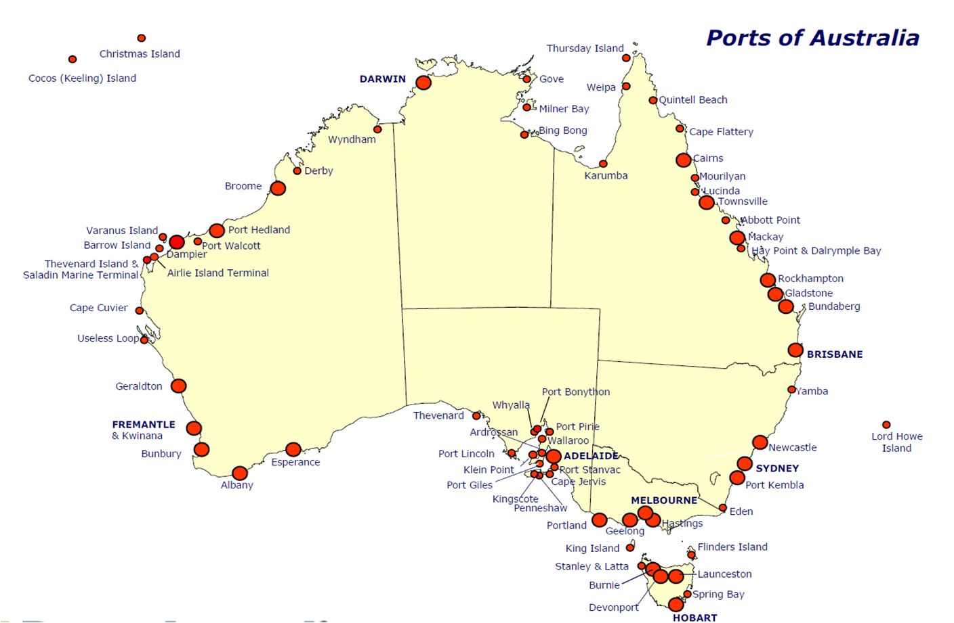
Total 70 Ports, of which 65 Regional
Main 16 Regional Ports handle 85% of Task
Main 20 Ports handle 95% of Task

Slide 7
An Historical Perspective
“That Port Authorities within the Commonwealth be recommended to keep each other informed from time to time ....”
“ .... The Statutes relating to Harbors and Harbor Authorities where they have becoming cumbersome owing to amendments be consolidated by the Legislature of such State”
“ ..... should present the Resolutions to the next Conference of State Premiers with a view to securing such Parliamentary measures or other necessary action in the States as may be required to facilitate uniformity of action by Port Authorities ......And ..... the Conference of State Premiers be urged to make representations to the Commonwealth Government in order to secure the objects of the Resolutions”
First Inter-State Harbor Conference – Melbourne, November 1916
Extract From Resolutions

Slide 8
Threats to Port Competitiveness – The Short Story
Community (also read political) attitudes to freight facilitation
Incapacity to plan for robust trade growth
Supply Chain Disconnects
Regulatory Risk
Productivity and Landside Costs
Governance Models
Sourcing the skilled people

Slide 9
Start With A Conversation About Freight
A greater preparedness on the part of governments to promote public awareness of the importance of freight is, in our view, a threshold issue. Governments readily engage with their constituencies on standards of living and the price of consumables but stop short of drawing a nexus between these issues, and the performance of the freight transport sector, and port development and efficiency in particular.
Ports Australia Submission to Infrastructure Australia, October 2008
Freight is a big deal Minister
Governments getting better at fostering this discussion
  still quick to revert to political imperatives
  locating political champions and embedding freight management as an all-of-government/all-of-agency
  approach is a necessity

Slide 10
Enter the National Ports Strategy (NPS) - Drivers
Trade Growth (having capacity as well as competitiveness)
Planning Failures and Land Use Conflicts
  urban encroachment
Maximising Benefits of Portside Investment
  landside capacity
  ports and supply chains
Facilitating timely and predictable expansion in capacity
  appropriate regulatory and approvals regimes
Co-existence of Cities/Communities and Freight
  functional ports and functional communities ("liveability")
Languishing National Productivity

Slide 11
Forecast Trade Growth
Container Trades
5%-7.5% cag; port throughput to increase 3 to 6 times in 25 years
7.5% cag; container task will double by 2030
Bulk Trades
Iron ore, 5% cag; 350mt 2008/09 to 800mt 2030
10% growth; 2100mt by 2030
Coal, 5% cag; 260mt 2008/09 to 700mt 2030
7.5% growth; 1200mt by 2030
LNG to become leading export by value
Reflecting on forecasting and global risks

Slide 12
Sydney’s Growth Projections – 30 Year
Source: Sydney Ports

Slide 13
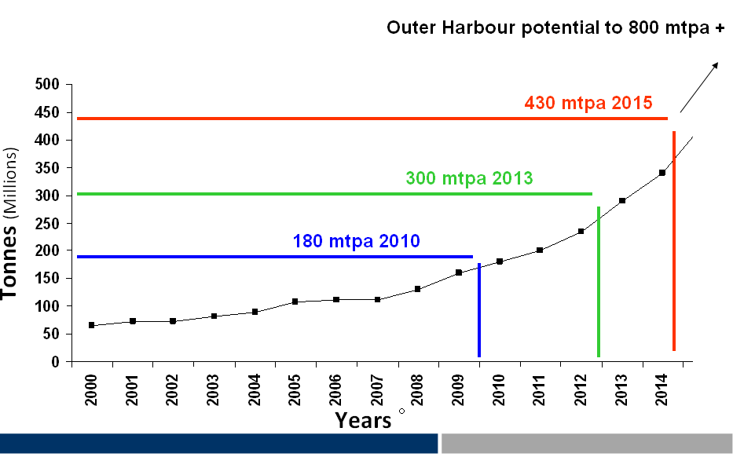
Port Hedland Port Growth Projections
Source: Port Hedland Port Authority

Slide 14
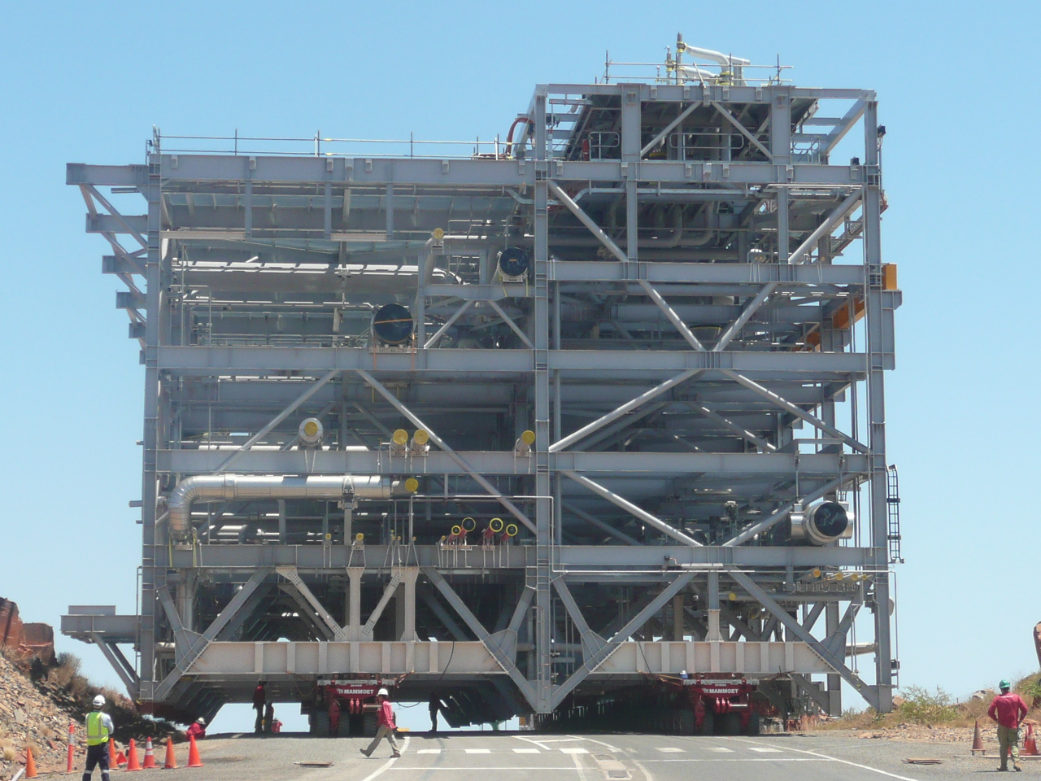
Dampier Port Authority - Module Movements
435 modules bought through Dampier to date – a now well-established construction method for LNG plants.
Source: Dampier Port Authority

Slide 15
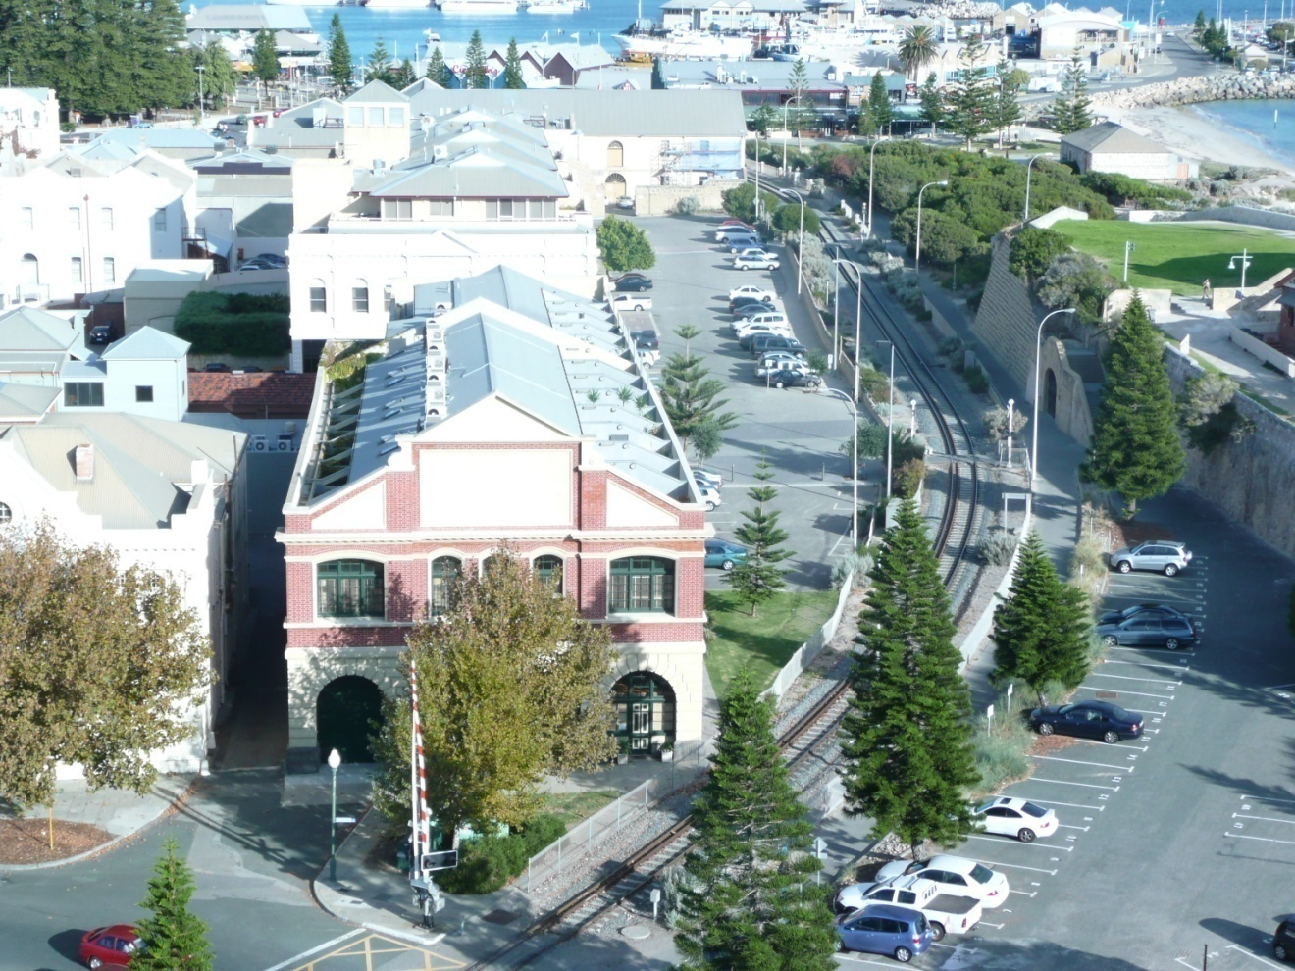
Planning Failures and Land Use Conflicts
Residential Apartments 2.5 – 25m from rail freight line.
Rail Freight Line
Rail Freight Line – Little High Street, Fremantle

Slide 16
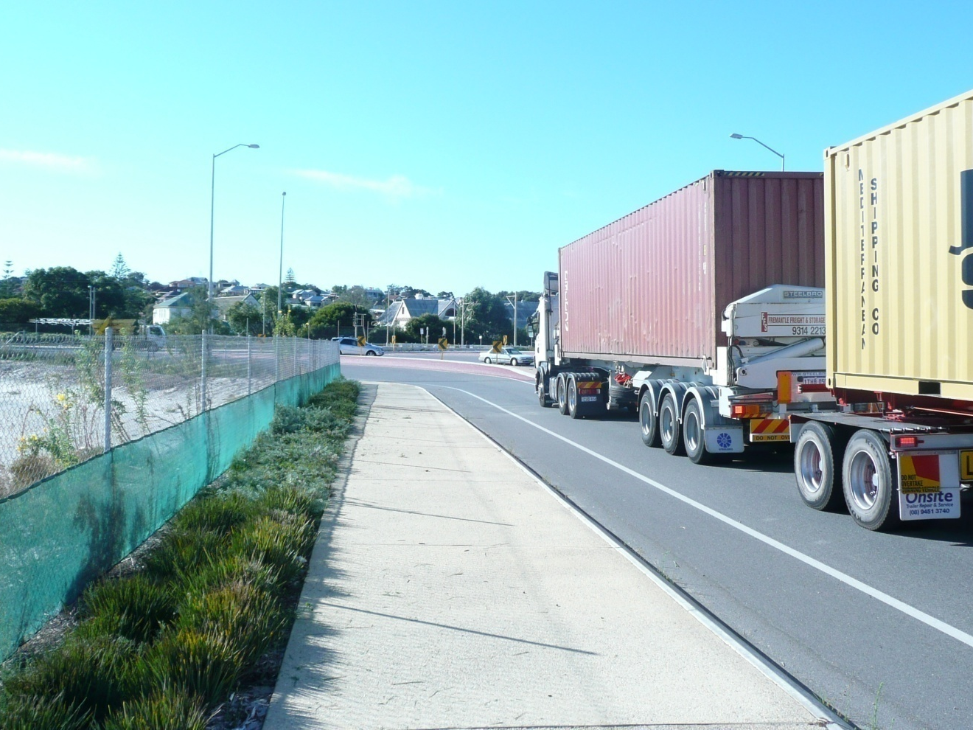
Urban Encroachment on Primary Road Freight Route
Proposed 5 level residential development
4 meters from road
Road freight route
Walter Place & Curtin Avenue, North Fremantle

Slide 17
The Ports Master Planning Process
Long term integrated master plans for ports guided by best practice
Facilitation by range of support mechanisms
  expert panel and proactive agency support
  BITRE
  BREE
Recognition and ownership of port plans by
  governments
  supply chain stakeholders
  communities

Slide 18
Supply Chains –
Things Never Change but Everything is Different
"... almost eight years after the extravagances and inefficiencies of the transport chain from the warehouse to the wharf began to be exposed little has been done to remove them". (ISC, Webber Report)
"Participants along the chain have each operated within their own discrete worlds without regard to the impact of their actions on the overall efficiency of the chain.
"While improved efficiency, reliability and lower transport costs may not be a priority for individual firms, taken collectively, they are major issues in helping Australia become more competitive in domestic and international markets"
(Warehouse to Wharf, HoR Standing Committee, April 1992)

Slide 19
Supply Chain Coordination and Efficiency Measures
Some good models now available
  Hunter Valley Coal
  MITEZ
  PBLIS
Exploring technologies
  opportunities for smart technology applications to freight management
  inspiring collaboration
Provision and management of access infrastructure
  including pricing

Slide 20
Regulatory Risks
Reputation as low risk country being degraded
  $100 billion in gas projects at risk because it costs three times as much to develop them here than in the Gulf of Mexico and twice as much as elsewhere (David Knox, AFR, 23/08)
Over-regulation including in
  environmental clearances and approvals (including dredging)
  maritime security
  labour
Cost shifting from government to industry
  eg security, EBPC cost recovery
COAG is talking the talk but not manifested in agency behaviour
  some agency cultures disconnected from macro-economic policies
  however some resolve apparent to reduce jurisdictional duplication (COAG says process is "broken")

Slide 21
National Ports Strategy seeks:
streamlined environmental regime and strategic assessment process
speed and predictability

Slide 22
Productivity and Landside Costs
Background work for NPS indicated landside costs very high comparative to total transport costs
Example: all the real growth in reported interface costs over last 13 years at five container ports is attributable to landside costs (BITRE)
  reflects a number of factors including truck and rail utilisation, congestion, and infrastructure management issues
Port productivity – first tier issue is accurate measurement
  NPS envisages improvements in measurement and benchmarking
At national level productivity is languishing
  annual decline of 0.7 % in Australia's productivity
  between 2005 and 2011; 2.4% 1993 to 1999
  figures show decline in both capital and labour productivity

Slide 23
NATIONAL PRODUCTIVITY
Strong Growth in the 1990s (2.3% p.a.)
Declining Growth since 2003-04 (-0.4% to 2008-09)

Slide 24
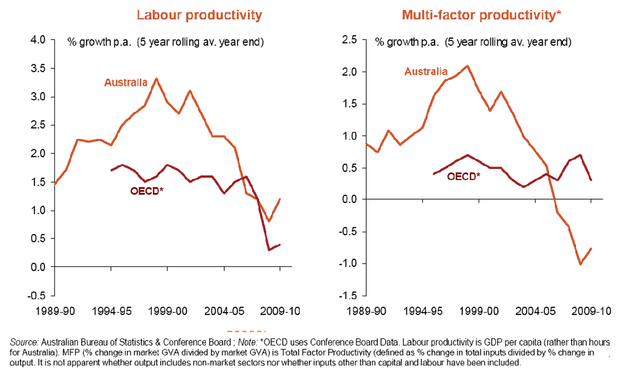
National Productivity
Productivity growth has slowed in most OECD countries (Source: Grattan Institute)
Strong Growth in the 1990s (2.3% p.a.)
Turning negative over past five years

Slide 25
Productivity – Labour Productivity Should Be Part of the Conversation
Federal Government constantly refers to the need for productive economy
but has excised labour productivity from the discussion
couches productivity in context of "education revolution", skills development and infrastructure spend
employers apparently not being sufficiently innovative and flexible (the ultimate irony), and in some instances tagged with Work Choices bogey.

Slide 26
Comparison of International Stevedoring Salaries (Real 2012 AUD)
Country | 2012 Annual Remuneration at Current Exchange Rates | 2012 Annual Remuneration at 2005 Exchange Rates
United Kingdom | 37,929 | 61,450
United States of America | 62,574 | 88,552
New Zealand | 71,886 | 84,065
Australia | Approx. 100,000 | Approx. 100,000
Sources: UK Office for National Statistics, Salary.com, Ernst & Young, SupplyChainReview.com.au, www.oanda.com
Notes: Numbers represent the full stevedoring remuneration package.
UK salary is for 2011 and is inflated at the average of the previous two years’ increases, Australian salary is 2011 but is not inflated as it was only given as a broad estimate.

Slide 27
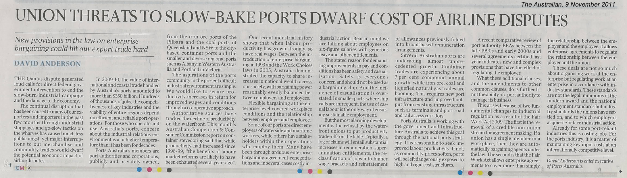

Slide 28
ACCC – Container Stevedoring Monitoring Report No. 13 (p. 30)
Results of the ACCC's monitoring program shows that some measures of productivity – namely the elapsed labour rate and the ship rate on a container per hour and on a per TEU basis – have generally increased since 1998-99. This is likely to reflect more flexible labour arrangements over the last decade. However, the benefits of labour market reforms are likely to have been exhausted several years ago. Current enterprise wage negotiations between the Maritime Union of Australia (MUA) and each of the stevedoring companies are significant as they set the terms at which higher wages outcomes will be offset against labour-based productivity gains over the next three years.
October 2011

Slide 29
Fair Work Act – General Observations
Its the regime we did not need to have
Limits ability of a port authority to manage its business
new and complex provisions with effect of regulating the employer
removal of credible non-union stream for agreement making
allows enterprise agreements to regulate relationship between employer and union (union standards not modern award standards)
Long, drawn out, costly EBA negotiations
protected strike action for indefinite periods
Asciano has been negotiating 18 months

Slide 30
Governance
Improvement of governance models for publicly owned ports a major issue
  in the first instance its about settings provided by government shareholders
  does not need to involve a debate about ownership
Behave as privately owned organisations (clarity of roles and responsibilities)
strategic economic managers (off port investments and freight priority)
act in a transparent and even handed manner
jurisdictional review of legislation
  clarity of function
  Boards
  leadership role
  master planning
  best practice principles
Shareholder governments will have different views
  but there are some base line imperatives

Slide 31
Skilled People in Demand
Tightness in labour market in some particular sectors impacts on competitiveness
  wage costs and boom cultures
  causes capacity constraints
  distorts labour market
  structural rigidities
Labour immobility part of the problem
  how sustainable overseas recruitment?
No silver bullet
  companies with innovative retention strategies have market edge (value propositions not total panacea)

Slide 32
danderson@portsaustralia.com.au
Ports Australia 43rd Biennial Conference
Adelaide, 24 and 25 October 2012

