Slide 1

Improving Export Performance through Supply Chain Efficiency
Speech by
Michael Kilgariff
Managing Director
Australian Logistics Council
Building Competitiveness in our Export and Maritime Industries Conference
24 August 2012

Slide 2
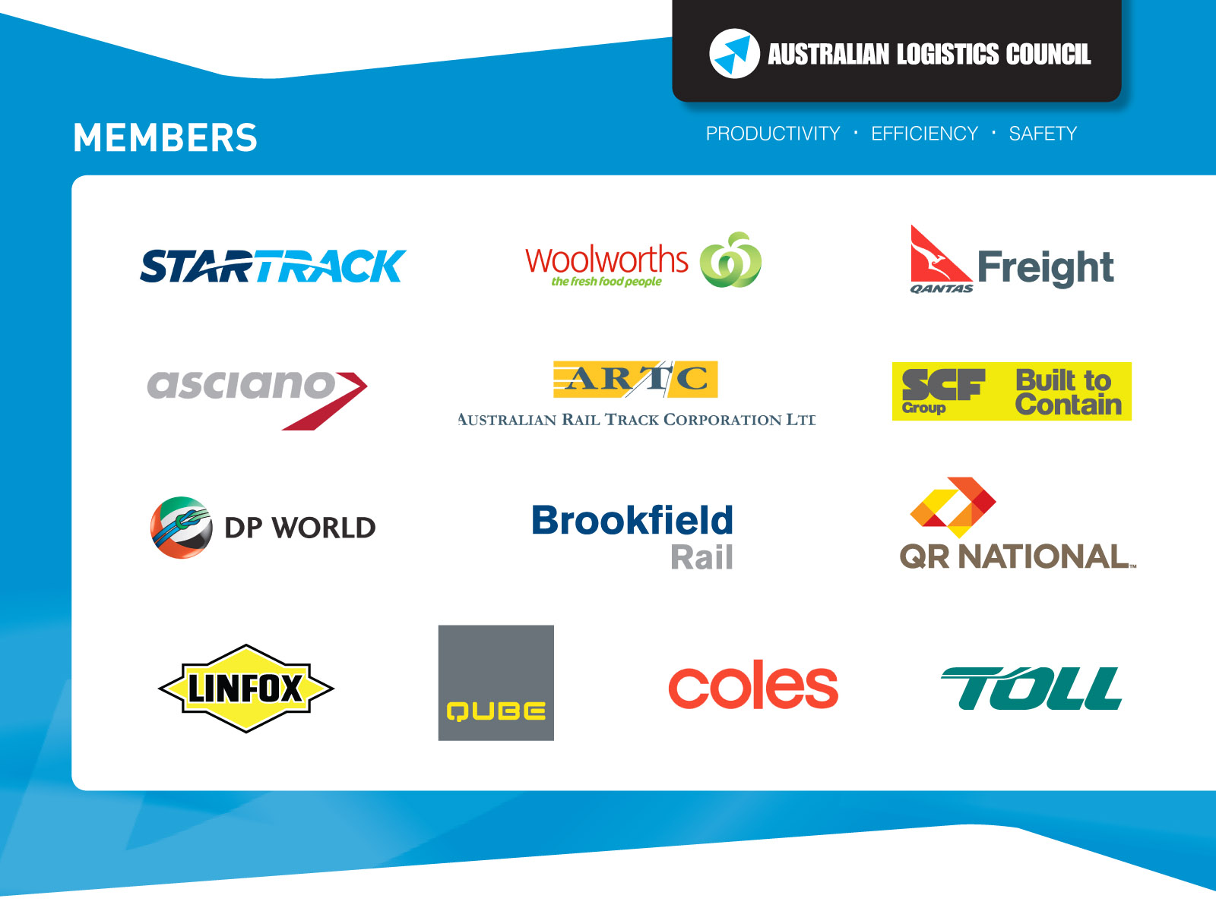

Slide 4


Some industry facts
Australia is facing a rapidly increasing freight task:
- 500 billion tonne kilometres in 2010
- 1000 billion tonne kilometres in 2030
- 1400 billion tonne kilometres in 2050.
The Bureau of Infrastructure, Transport, Transport and Regional Economics (BITRE) estimates cargo loaded at Australian ports has increased from half a billion tonnes from 2000 to 1 billion tonnes in 2010.

Slide 5
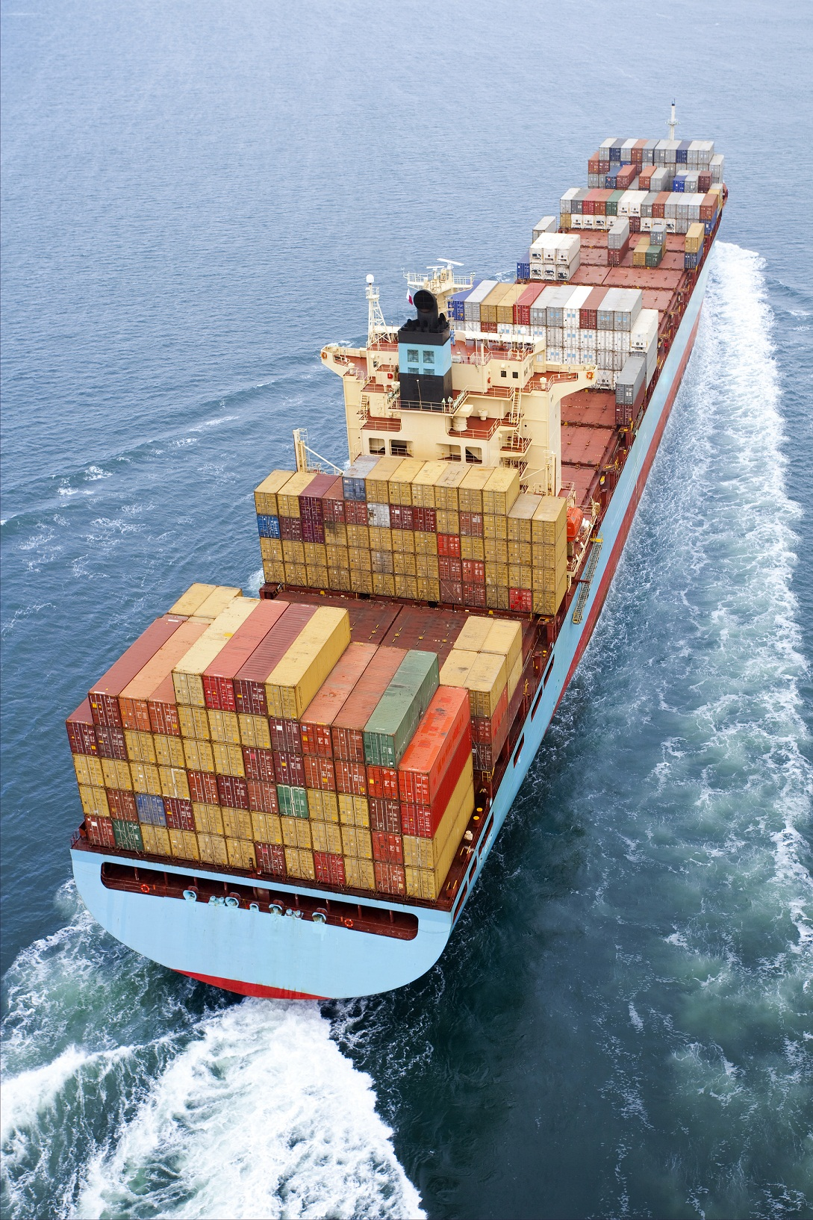
Addressing poor productivity
Productivity in the transport sector is estimated to have increased by only 0.6 per annum in the five years to 2011.
Prime Minister’s Manufacturing Taskforce highlighted the link between manufacturing productivity and transport
Asciano – actively seeking to increase productivity at Port Botany
MUA actively campaigning against Asciano’s attempt to improve efficiency
Another example of unions attempt to gain greater control over the way businesses run their operations

Slide 6
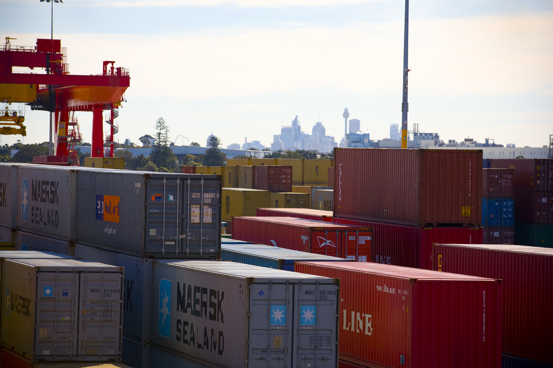
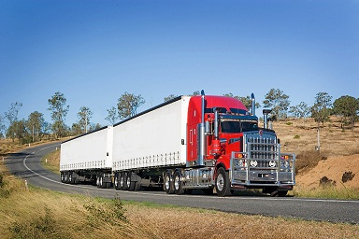
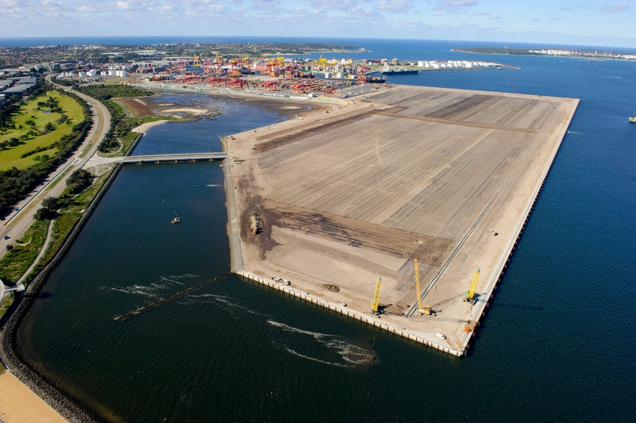
Progress in NSW
Important progress on improving rail freight capacity in Sydney; Moorebank & PBLIS
NSW Long Term Transport Master Plan – ALC submission included 16 recommendations on road, rail, planning and pricing to improve supply chain efficiency
Dedicated freight and port strategies to flow from the NSW Master Plan

Slide 7


Plans, Plans and more Plans…!
Heavy Vehicle Charging and Investment Reform (HVCI) examining possible reforms to heavy vehicle charging and investment.
National Freight Strategy – Infrastructure Australia’s long term blueprint to guide the sector’s long term growth.
ALC supports this renewed focus by governments on freight, but we also need action now to improve supply chain efficiency.

Slide 8
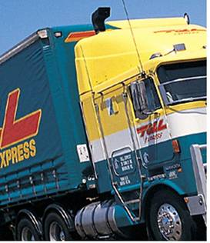
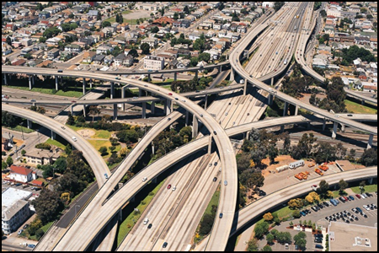
The road ahead for NSW
Corridor preservation critical for future growth and prosperity
Role for Infrastructure NSW which needs to take a take a long term view
Funds must be available to locate and buffer port and intermodal facilities
ALC supports WA’s ‘beneficiary pays’ model

Slide 9
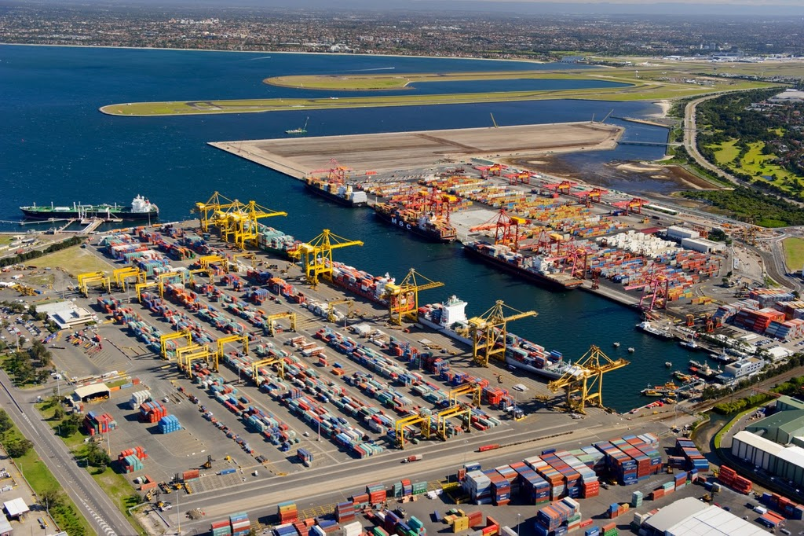
National Ports Strategy
NPS contains some important initiatives, including identifying key freight strategic routes and establishing a ‘coordinator general’ in jurisdictions
ALC is disappointed the Strategy includes the concept of ‘opting-in’
To enhance productivity and improve efficiency, there can be no ‘opting-in’ on reforms
ALC’s National Partnership proposal - one of the keys to tackling last mile issues

Slide 10

National Transport Reforms
Reform involves replacing 23 regulators with 3 for heavy vehicles, maritime safety and rail safety
The economic benefits are significant – the establishment of a National Heavy Vehicle Regulator estimated to be worth approximately $12.4 billion to the economy over 20 years
The key to success is ensuring regulators have sufficient staff and resources
The freight logistics industry (and Australian exporters) cannot afford another layer of bureaucracy

Slide 11

Conclusion
The old saying “Freight Doesn’t Vote” undervalues its contribution to the economy:
Generates 14.5% of Australia’s GDP.
provides more than 1 million jobs across
165,000 companies.
The time for action is now, and turn plans and rhetoric into action

