Slide 1
AUSTRALIA’S INTERNATIONAL RANKING ON COMPETITIVENESS
Professor the Hon Stephen Martin
Chief Executive
Building Competitiveness in our Export and Maritime Industries Seminar
FOUR POINTS BY SHERATON, DARLING HARBOUR
FRIDAY 24AUGUST

Slide 2
Australia August 2012
Multi-speed economy? GDP and Unemployment figures paint a picture of economy on steroids
Mining dominates with massive investment already in the pipeline but some uncertainty as to its future- employs 7% of Australia’s workforce
Services Sector that employs 80% of the workforce experiencing mixed fortunes- retailing, tourism affected by $A
Manufacturing- structural adjustment
Effects of international economic conditions- Europe, US and China

Slide 3
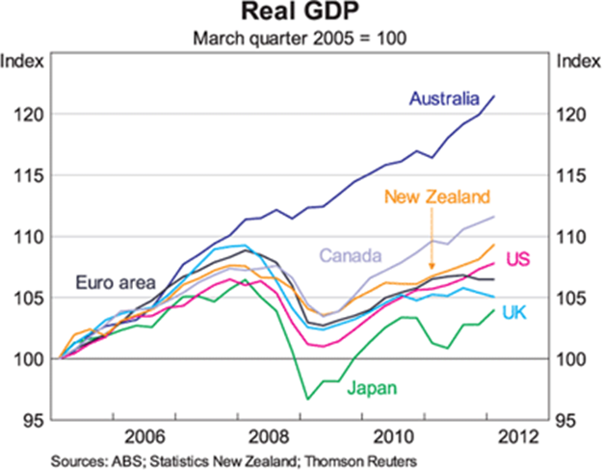
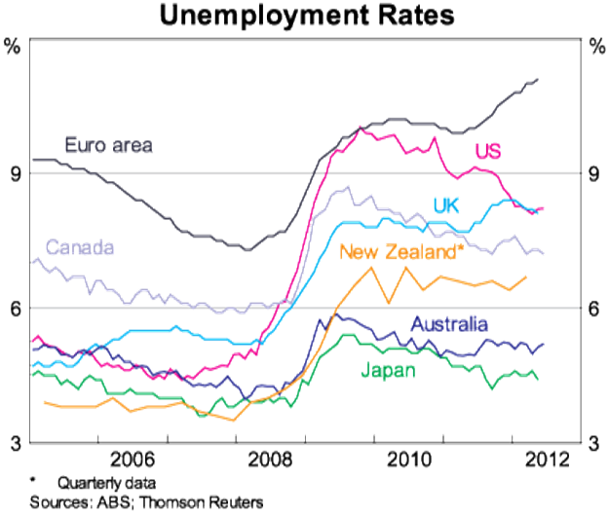

Slide 4
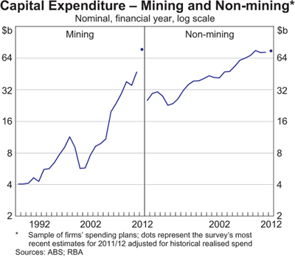
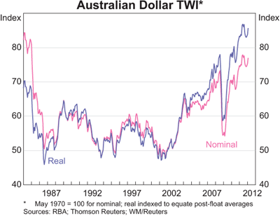

Slide 5
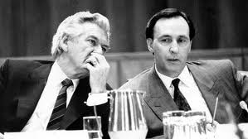
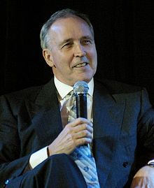
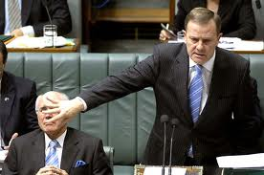
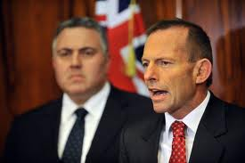
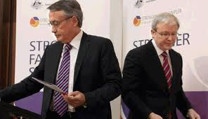
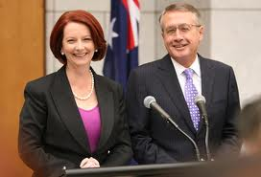
Drivers of Productivity and Competitiveness

Slide 6
Competitiveness

Slide 7
World Economic Forum
Competitiveness defined as the set of institutions, policies, and factors that determine the level of productivity of a country.
Many determinants driving productivity and competitiveness- including education and training, technological progress, macroeconomic stability, good governance, firm sophistication, and market efficiency
Ranked 20/133
Advantages included financial system and banking sector; low government debt; macro-economy; institutional transparency
Disadvantages included burden of government regulation; lack of innovation; business sophistication

Slide 8
WEF Assessment of Australia
Australia’s Advantages are:
efficient financial system, supported by a banking sector that counts among the most stable and sound in the world performance in education
macroeconomic situation
low government debt
transparent and efficient public and private institutions, physical security
Australia’s disadvantages are:
burden of government regulation
innovation
business sophistication
infrastructure.

Slide 9
Global Competitiveness Index
 |  |  | Rank (out of 142) | Score (1-7)
GCI 2011-12 |  |  | 20 | 5.1
GCI 2010-2011 (out of 139) |  |  | 16 | 5.1
GCI 2010-2011 (out of 133) |  |  | 15 | 5.2
Basic requirements (20.0%) |  |  | 14 | 57
Institutions |  |  | 13 | 5.4
Infrastructure |  |  | 24 | 5.4
Macroeconomic environment |  |  | 26 | 5.6
Health and primary education |  |  | 10 | 6.5
Efficiency enhancers (50.0%) |  |  | 12 | 5.2
Higher education and training |  |  | 11 | 5.6
Good market efficiency |  |  | 22 | 4.8
Labour market efficiency |  |  | 13 | 5
Financial market development |  |  | 6 | 5.4
Technological readiness |  |  | 22 | 5.1
Market size |  |  | 19 | 5.1
Innovation and sophistication factors (30.0) |  |  | 26 | 4.6
Business sophistication |  |  | 29 | 4.7
Innovation |  |  | 22 | 4.5
The Global Competitiveness Report 2011-2012 © World Economic Forum

Slide 10
IMD World Competitiveness Yearbook
Australia ranked 15/59- a drop of 10 places in two years
Labour Market competitiveness affected by $A, skills shortages and industrial relations
High-cost high-skill economy cf emerging economies
Future of the mining boom, China’s growth, investment decisions, emerging competitors (Africa)
Manufacturing- subsidies and strategic interest test

Slide 11
EIU Global Index of Workplace Performance and Flexibility
Ranked 8/51 overall, but 34 on economic performance
Regulatory framework particularly in industrial relations singled out as the major contributor
Related to 2010 data however with changes to workplace relations signalled

Slide 12
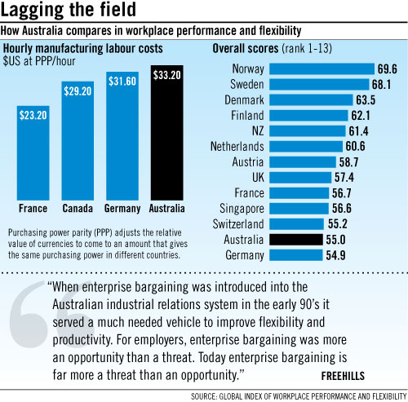

Slide 13
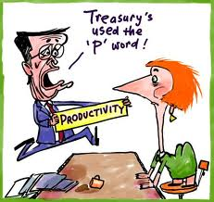
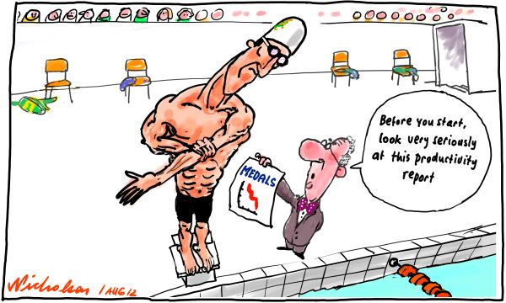
Productivity

Slide 14
Productivity
'Productivity isn't everything, but in the long run, it's almost everything. A country's ability to improve its standard of living over time depends almost entirely on its ability to raise its output per worker.' Paul Krugman
More than reforming Fair Work Act 2009
Labour and multi-factor productivity
Effect on employment

Slide 15
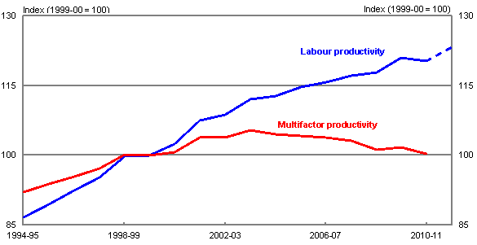

Slide 16
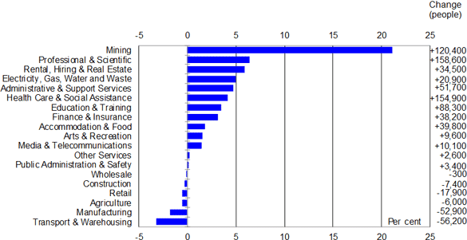
Employment growth by industry — May 2009 to May 2012 Annual average percentage change
Treasury calculations based on ABS Cat. no. 6291.0.55.003

Slide 17
McKinsey Global Institute Report
Labour productivity has risen by 0.3 per cent a year since 2005, adding $17 billion in income annually, down from $57 billion in the 1990s
Possible scenarios for Australia’s income growth:
Paradise: 3.7 per cent annual growth if the terms of trade remain high and productivity is restored
Lucky escape: 2.4 per cent if the terms of trade stay elevated and productivity stays stagnant
Earned rewards: 1.8 per cent per year if the terms of trade fall while productivity is revived
Hangover: 0.5 per cent per year, or almost no income growth, if the worst-case scenario occurs for both the terms of trade and productivity

Slide 18
Manufacturing Taskforce Report Recommendations
A government-led effort to win Australian companies a bigger share of supply contracts for the $470 billion of mining-related investment in the pipeline, rather than see most of it go to imports.
Bringing research institutes and industry together in ''smarter Australia precincts'', like Melbourne's Parkville medical precinct, so more of Australia's research expertise is directed towards making new products or improving them.
Building on Australia's strengths by processing raw materials before export, especially processed food for Asia's markets.
Developing more global niches in knowledge-intensive manufacturing, as Futuris has done in automotive interiors and CSL in plasma.
Monitoring the impact of the carbon tax on emission-intensive industries, and ensuring it is ''refined as needed'' to keep firms globally competitive.

Slide 19
Innovation, Skilling and Education- Drivers of Competitiveness and Productivity

Slide 20
Innovation
Milken Innovation Report
a global analysis of the innovation environment in 22 countries and assessed country performance across seven innovation indicators.
Australia was a leading nation for innovation in university-industry collaboration, R&D expenditure, patents, STEM education and business environment, and Above Average in venture capital deals and technology exports.
Energy, healthcare and telecommunications would benefit most in terms of job creation and increased profits if governments implemented more efficient innovation policies.

Slide 21
Skilling and Education
2012 National Workforce Development Strategy
Modelling confirms demand for high levels of skills can be expected to continue into the future in response to
technology-induced change
structural adjustment
a progressive shift to services-based industries, Australia’s changing demographics
increasing globalisation with Asia a burgeoning market for Australian services.
Role of tertiary education sector, disability sector, jobs for all

Slide 22
Australia’s Future
Australia’s current economic prosperity supported by past policies focused on international competitive advantage, including innovation and educational up-skilling- needs to be reinvigorated and targeted
In the 1990s Australia was a leader in business innovation- lack of global competition and a relatively stable economy has created a complacent society and has not provided any incentive for business to innovate contributing to our productivity slowdown.
Increased investment in skills, in particular science, research and technical skills, would allow us to be a leader in high value, high-tech manufacturing and in resource extraction and development, increasing our ability to deliver high value product.
Role of services sector – has not demonstrated productivity, immune from PC examination eg Health, Education. Export opportunities.

Slide 23
Conclusion
Australia’s economy is strongly driven by mining but real opportunities in the future are in the services sector but PC-type blowtorch needed
Reforms required in the tax system, elements of workplace relations, regulatory frameworks and public spending
Increased investment in education and skills- science, research and technical skills- is vital
Long-term skills plan required for Australia with innovation as a key driver to ensure we can capitalise on growth sectors that can and will contribute to Australia’s future prosperity
Government and business partnerships
Global competitiveness and productivity, not simply reliance on The Asian Century.

Slide 24
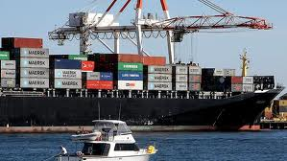
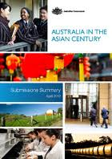
THANK YOU

