Slide 1
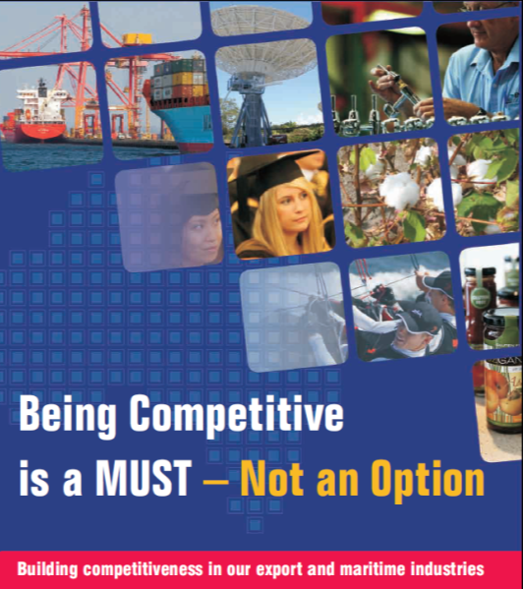
ECA-SAL Conference
Sydney, 24 August 2012
Customs Policy
Professor David Widdowson
Centre for Customs & Excise Studies, University of Canberra

Slide 2
Levels of Policy
Government Policy:
Laws relating to international trade
Administrative Policy:
The way in which those laws are administered

Slide 3
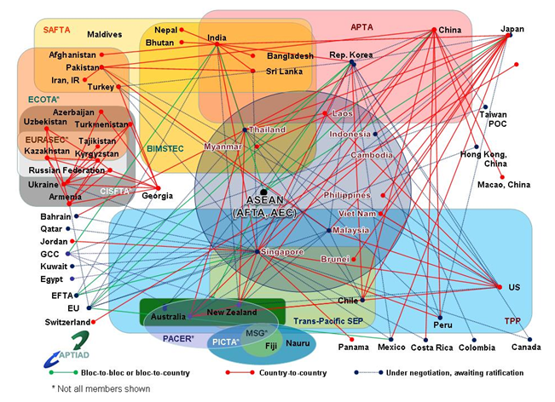
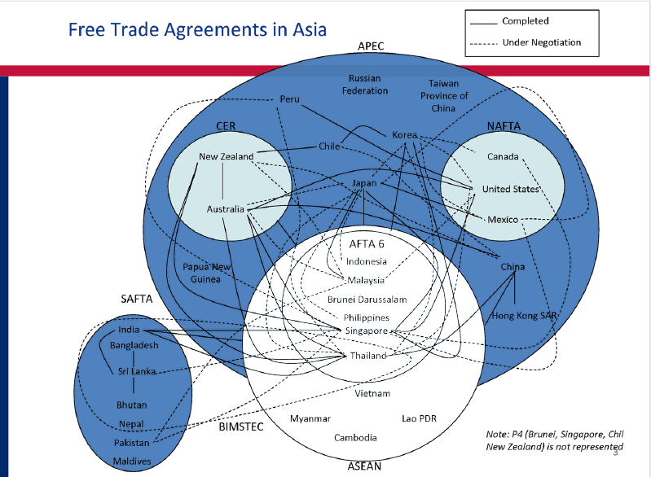
Legislative Issues
Preferential Rules of Origin:
Giving effect to Free Trade Agreements

Slide 4
Legislative Issues
Prohibited and Restricted Goods:
That may threaten community health, public safety and national interests

Slide 5
Administrative Issues
Trade Measures:
WTO Anti-Dumping Agreement
Protecting domestic manufacturers from
unfair import competition
or simply import competition?

Slide 6
Administrative Issues
Trade Facilitation:
Facilitating legitimate trade

Slide 7
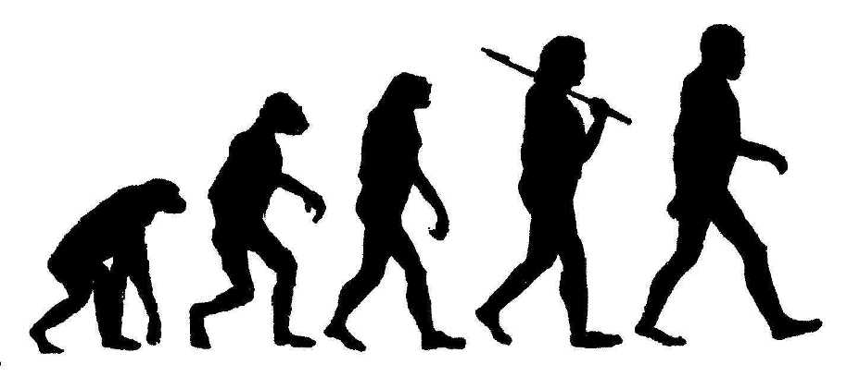
Evolutionary Trends

Slide 8
Evolutionary Trends
Protection of Domestic Industry
Community Protection
Trade Facilitation
Revenue Collection
Supply Chain Security

Slide 9
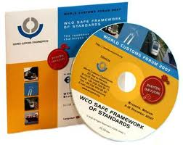
SAFE Framework of Standards
Designed to secure and facilitate trade
Key concepts:
Authorised Economic Operator
Mutual Recognition
166 WCO members have agreed to implement

Slide 10
Authorised Economic Operator
A party involved in the international movement of goods that is deemed to comply with WCO or equivalent supply chain security standards
“…companies that demonstrate a verifiable willingness to enhance supply chain security will benefit. Minimizing risk in this way helps Customs in performing their security functions, and in facilitating legitimate trade”

Slide 11
Authorised Economic Operator
“Australia’s border management agency has a responsibility to support legitimate trade and travel which it will do through:
Promoting measures that allow Australia to be seen internationally as a secure trading partner
Assisting Australian industry to meet the requirements of overseas authorised economic operator and like arrangements”
ACBPS December 2007

Slide 12
Authorised Economic Operator
Australian survey conducted
Key information missing:
What is an AEO program?
What would an Australian AEO program look like?
What costs would be involved?
What benefits would be involved?

Slide 13
Authorised Economic Operator
What Customs concluded from the survey:
“The results of the survey indicate that industry believes the cost of implementing an AEO program will outweigh the associated benefits. For this reason a cost-benefit analysis would be of little value at this time.”

Slide 14
Authorised Economic Operator
To sum up:
Why Customs wanted it:
“It provides Customs with the ability to re-focus resources on higher risk activities, clients and commodities by recognizing the low risk and high levels of compliance by a Customs-identified Accredited Client group”
Why Customs rejected it:
“It’s not attractive to traders”

Slide 15
Authorised Economic Operator
International enabler
Mutual Recognition is critical
Element of future FTA negotiations
Commercial prerequisite

Slide 16
david.widdowson@canberra.edu.au
www.customscentre.canberra.edu.au

